Slide 1
Security Hardening – Case Study – L3 Switch
Infrastructure Layer 3 Switch STIG
DISA, Release 22
28 April, 2017

Slide 2
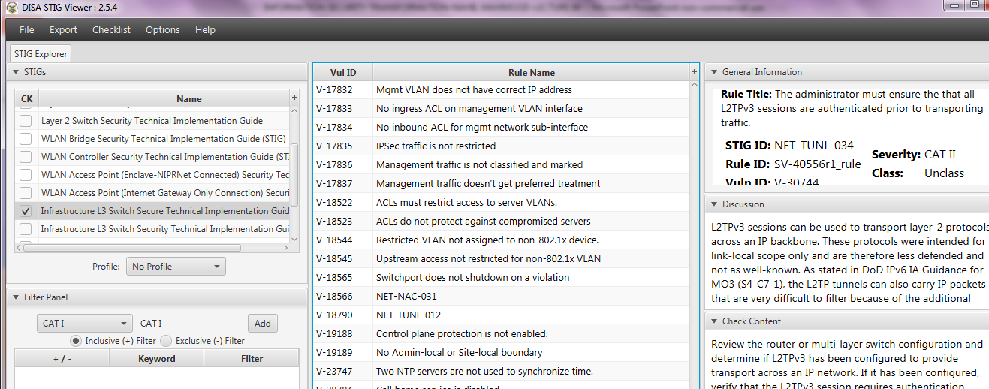
Security Hardening – Case Study - L3 Switch
STIGVIEWER WINDOW

Slide 3
Security Hardening – Case Study - L3 Switch
General Information:
Rule Title : The administrator must ensure the that all L2TPv3 sessions are authenticated prior to transporting traffic.

Slide 4
Security Hardening – Case Study - L3 Switch
General Information:
Vuln ID: V-30744
STIG ID: NET-TUNL-034
Severity: CAT II

Slide 5
Security Hardening – Case Study - L3 Switch
Discussion:
L2TPv3 sessions can be used to transport layer-2 protocols across an IP backbone. These protocols were intended for link-local scope only and are therefore less defended and not as well-known.

Slide 6
Security Hardening – Case Study - L3 Switch
…Discussion:
…As stated in DoD IPv6 IA Guidance for MO3 (S4-C7-1), the L2TP tunnels can also carry IP packets that are very difficult to filter because of the additional encapsulation.

Slide 7
Security Hardening – Case Study - L3 Switch
…Discussion:
…Hence, it is imperative that L2TP sessions are authenticated prior to transporting traffic

Slide 8
Security Hardening – Case Study - L3 Switch
Check Content:
Review the router or multi-layer switch configuration and determine if L2TPv3 has been configured to provide transport across an IP network. If it has been configured, verify that the L2TPv3 session requires authentication.

Slide 9
Security Hardening – Case Study - L3 Switch
Check Content:
…see detailed explanation in Check Content…(configurations)

Slide 10
Security Hardening – Case Study - L3 Switch
Fix Text:
Configure L2TPv3 to use authentication for any peering sessions.
END

